Slide 1
ELECTRIC FLUX AND GAUSS LAW

Slide 2
COULOMB'S LAW AND FIELD INTENSITY
Coulomb's law is an experimental law formulated in 1785 by the French colonel, Charles Augustin de Coulomb.
It deals with the force a point charge exerts on another point charge.
By a point charge we mean a charge that is located on a body whose dimensions are much smaller than other relevant dimensions.

Slide 3

Coulomb's law states that the force between two point charges Q1 and Q2 is directly proportional to the product Q1Q2 of the charges and Inversely proportional to the square of the distance R between them.
where k is the proportionality constant. In SI units, charges Q1 and Q2 are in coulombs (C),
the distance R is in meters (m), and the force F is in newtons (N).
The constant £o is known as the permittivity of free space (in farads per meter) and has the value

Slide 4
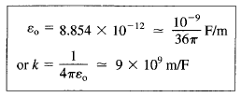

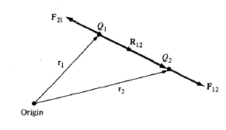
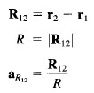

If point charges Q1 and Q2 are located at points having position vectors r1 and r2, then the force F12 on Q2 due to Q1 is given by

Slide 5


Electric field intensity
The electric field intensity (or electric field strength) K is the force per unit charge when placed in the electric field.

Slide 6
Example
Point charges 1 mC and - 2 mC are located at (3, 2, - 1 ) and (—1, —1,4), respectively.
Calculate the electric force on a 10-nC charge located at (0, 3, 1) and the electric field intensity at that point.

Slide 7

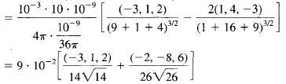
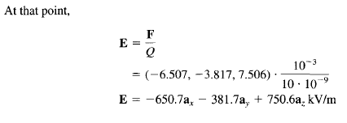
Solution

Slide 8


ELECTRIC FLUX DENSITY
This is the electric flux per unit Area
In SI units, one line of electric flux emanates from +1 C and terminates on - 1 C.
Therefore, the electric flux is measured in coulombs.
Hence, the vector field D is called the electric flux density and is measured in coulombs per square meter.
For historical reasons, the electric flux density is also called electric displacement.

Slide 9




GAUSS'S LAW
Gauss's law stales that the total electric flux V through any closed surface is equal to the total charge enclosed by that surface.

Slide 10


By applying divergence theorem to the middle term in eqs
Hence
This states that the volume charge density is the same as the divergence of the electric flux density.

Slide 11
Example

Slide 12

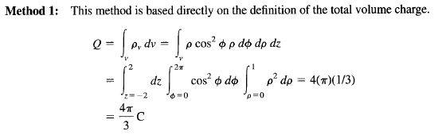
Solution

Slide 13
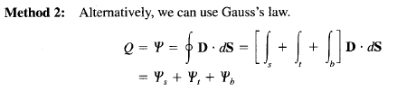
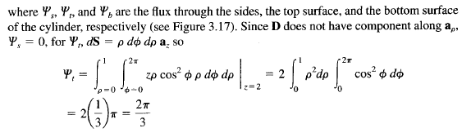
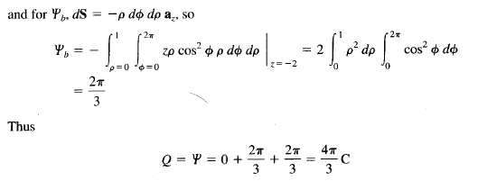

Slide 14
END

